Slide 1
MRA Project ML 2
Name- Hitesh Dadhich
Batch- Dsba_May2022
Email- Dadhichh7@gmail.com

Slide 2
Table OF CONTENT
Problem statement
Exploratory Analysis
Exploratory Analysis of data & an executive summary
Trends across months/years/quarters/days
Use of Market Basket Analysis
Association rules and their relevance in this case
KNIME workflow
Threshold values of Support and Confidence
Associations Identified
Associations in a tabular manner
Explanation about support, confidence, & lift values
Possible Combos with Lucrative Offers
Recommendations
Discount offers or combos

Slide 3
PROBLEM STATEMENT-
A Grocery Store shared the transactional data with you. Your job is to identify the most popular combos that can be suggested to the Grocery Store chain after a thorough analysis of the most commonly occurring sets of menu items in the customer orders. The Store doesn’t have any combo meals. Can you suggest the best combo meals?

Slide 4
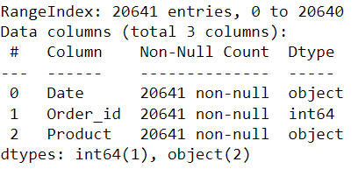
EXPLORATORY ANALYSIS-
Shape - Data has 20641 Rows and 3 columns.
Data information –

Slide 5
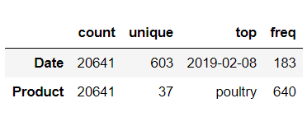
Descriptive summary –
There are total 37 unique product and poultry is the highest selling product.
It seems like maximum product was sold on the 2019-feb-08.
We have 3 data types present in the data date, object and integer.

Slide 6
Executive summary-
We review this problem statement in multiple steps:
First we check statistical summary of our data and identified the data type, rows in the data.
Then we visualize the data by using tableau and identified the pattern in the data like trend analysis across calendar and product sale.
After data visualization we used Knime software to do our market basket analysis in which we first grouped our data on order id column because 1 order contain multiple products.
After completing market basket analysis we got multiple rules along with the suggested item and for each item we got lift value.
We export this data in csv file and based on the suggested item try to make some offer/combos so this is all about we have done in this analysis.

Slide 7
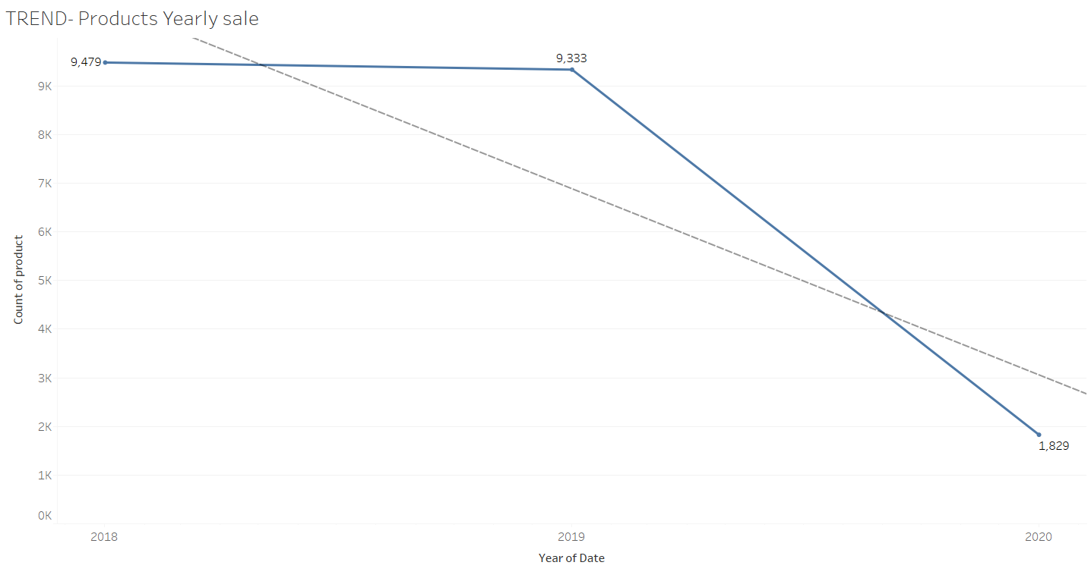
TREND AND PRODUCT ANALYSIS -
Trend

Slide 8
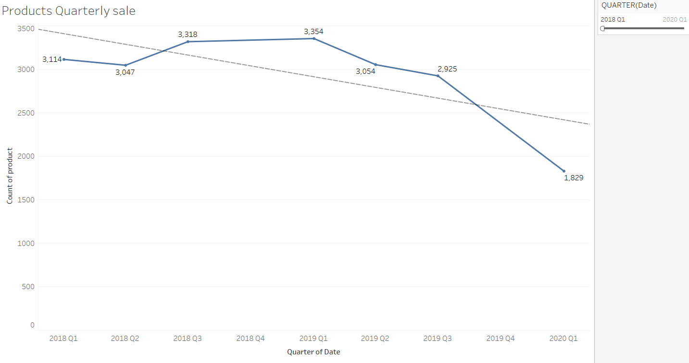
Trend

Slide 9
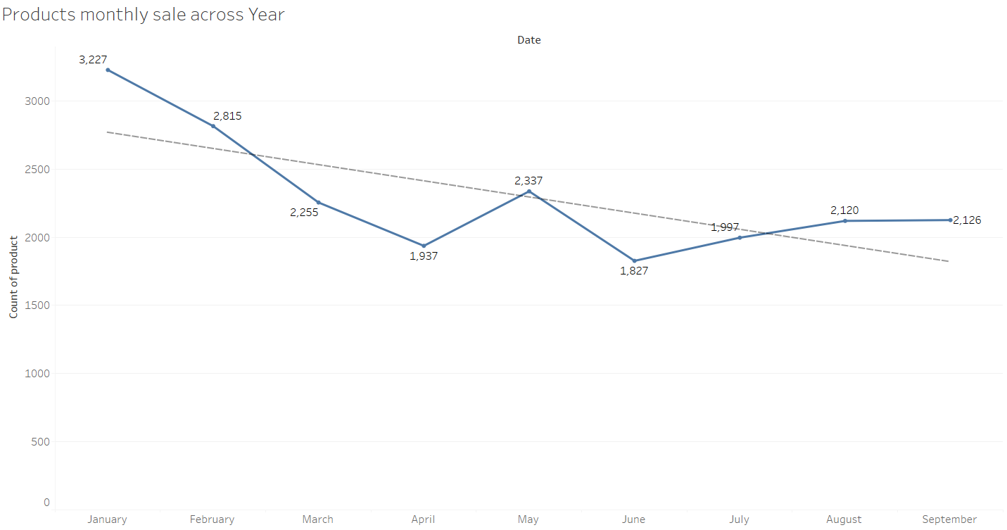
Trend

Slide 10
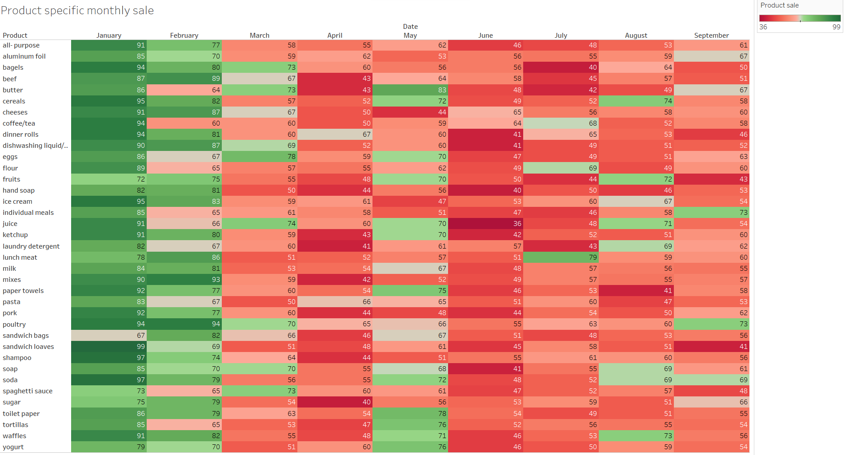
Analysis

Slide 11
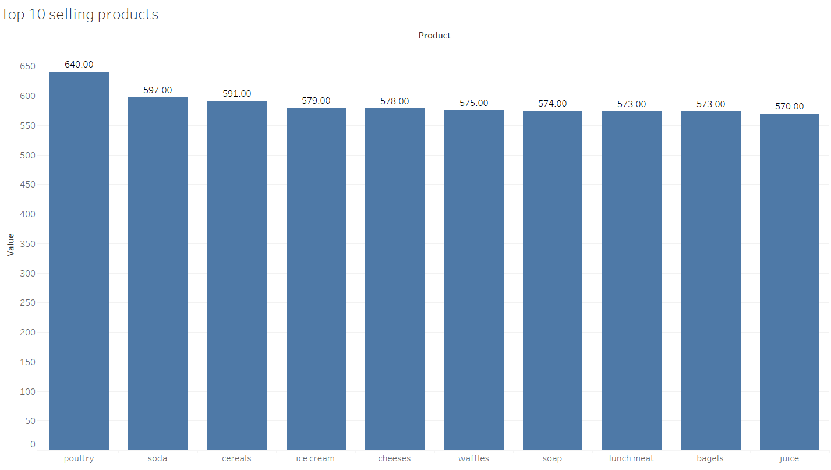
Analysis

Slide 12
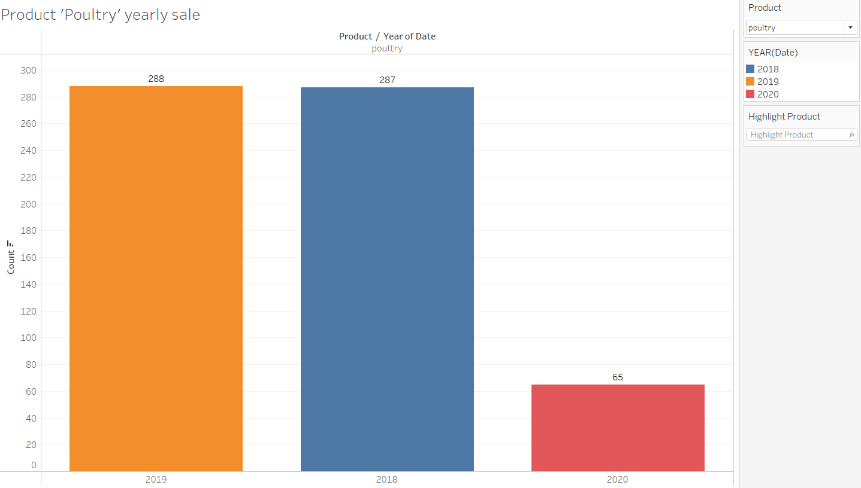
Analysis

Slide 13
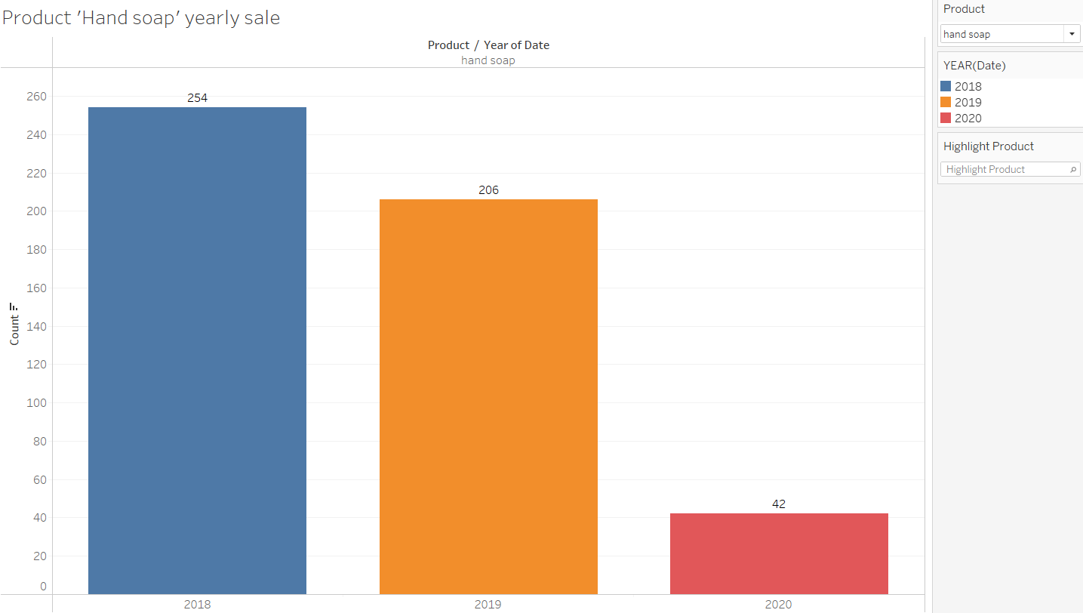
analysis

Slide 14
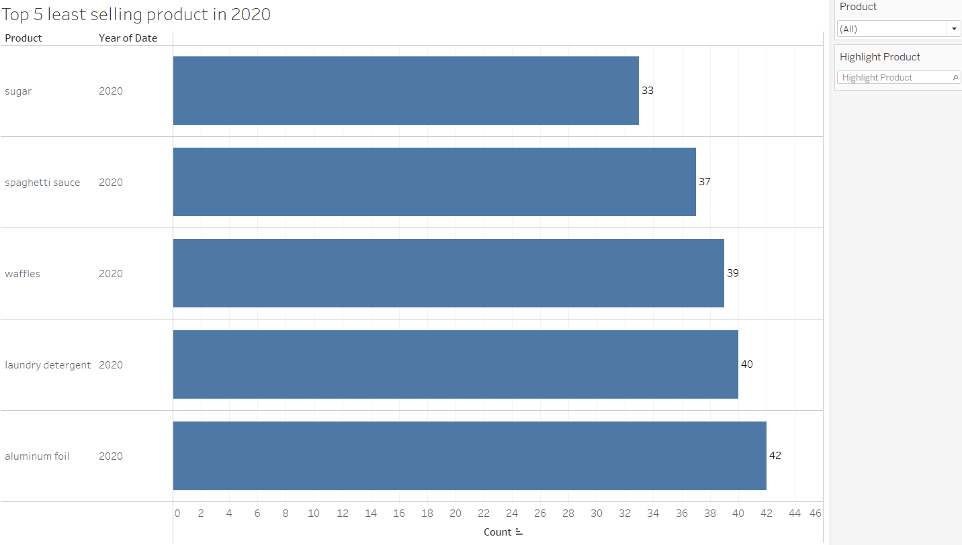
ANALYSIS

Slide 15
Conclusion –
As per yearly sales of the products we can see that overall year sale was almost constant from 2018 to 2019 but after that we can see decrease in sale.
We only have 2-month data available from 2020 so with the details of remaining month sales we can drive more output.
As per quarterly sales analysis we see that number of products sold in Q1 is good compare to other quarter except 2020.
We don’t have 4th quarter data available so why it’s not available? Was the shop close during that quarter because 4th quarter data can provide more insights as it’s festival/holiday time across the world.
As per monthly sales analysis we see that sales in January 2019 went down whereas it was good in 2018 and in 2020 we can say that January sales increase in 2020 may be because some sort of action was taken.
We can see that sales goes down after march and may month which we can see in the respective month April, June.
From product specific sales graph we can see that none of the product have significant sale for the month of April and June.
Product poultry has the maximum sales and hand soap has the lowest sale.
Based on the trend analysis we can say that sales decreasing with the time.
Due to the absence of 4th quarter this data does not provide solid quarterly analysis so monthly analysis can be used to make any business strategy.

Slide 16
ASSOCIATION RULES-
Market basket analysis is a technique to identify the association between items and here concept of association rule comes in picture as name suggest it try to find out association/combinations of items that occur together more often in transactions in sort it apply on the set of more than one product.
This technique can be used for this Grocery Store transactions because we have details of the product purchase in a transaction and by using this we can find out the suitable product that can be purchase by the customers with other products.
There are 3 metrics used in association rules:
Support – This measure provide that how frequent a itemset occur in all the transactions.
Confidence – This provide the probability of occurrence of suggested item on the cart given that the cart already have original items.
Lift – it’s the ration of confidence to probability of suggested item.
More the value of lift greater the chances of buying y when X already bought by customer.

Slide 17
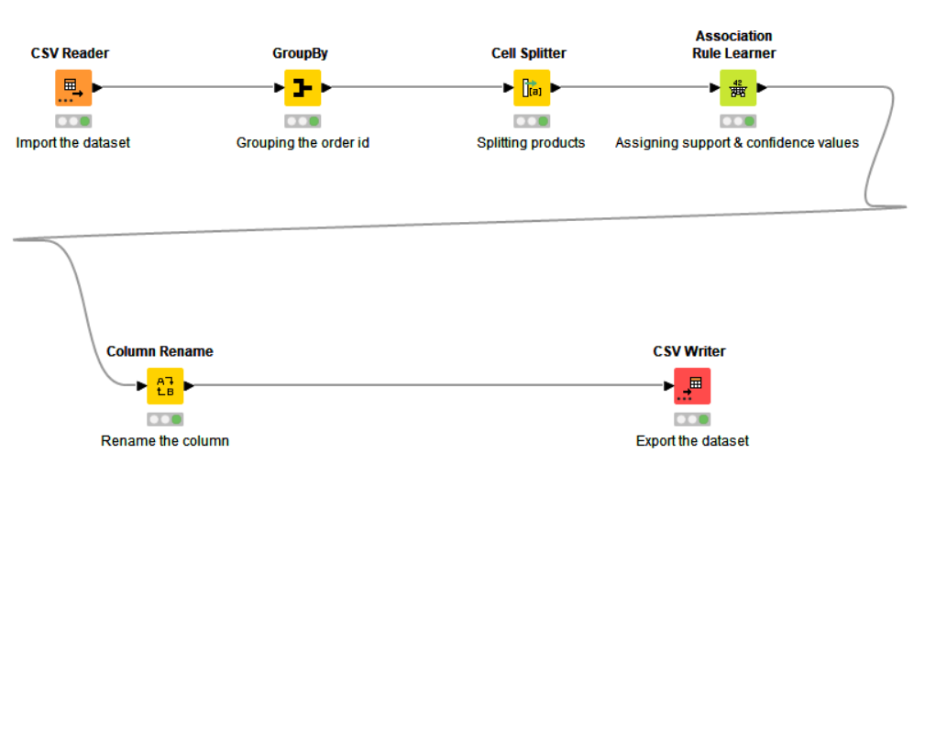
KNIME WORKFLOW -

Slide 18
SUPPORT AND CONFIDENCE-
We have taken Support as 0.05 and confidence as 0.5 though there might be a lot other values of support and confidence so we can not say it’s best value.
Support of 0.05 tells us the popularity of items and we know a particular item don’t get so popular that we choose support more than 1 or 2 also it depends on dataset.
Confidence of 0.5 tells us that there is 50 % chance of customer buying suggested/Consequent item given that he already bought original items.
With these values of support and confidence we got 1247 association rules which indicate the consequent item along with the item sets.

Slide 19
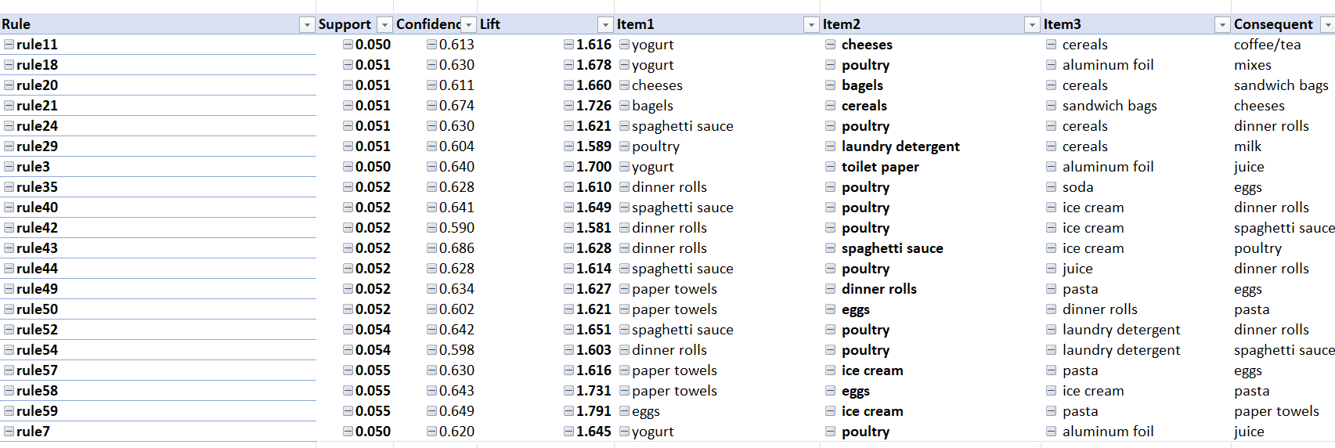
ASSOCIATION TABULAR FORM-

Slide 20
SUPPORT, CONFIDENCE & LIFT VALUES-
We got different values of support, confidence and lift after trying various threshold of support and confidence in association rule learner.
With these values of support, confidence and lift we can decide which product can be used as consequent and what is the chances of customer to buy this consequent based on the value of lift as value of lift more than 1 indicate higher chances of customer to buy suggested/consequent item along with other item.
For all rules we have support value ranges from 0.05 to 0.19 now if we have same lift value for more than 1 rule then we can go with the rule which has high support value as more support means more popular is the item.
Similarly for confidence we have value ranges from 0.5 to 0.68 now if we have same lift value for more than 1 rule then we can go with the rule which has high confidence value as more confidence means more chances of buying suggested item given that other items already in cart.
For lift we have maximum value as 1.79 which is more than 1 and it means the consequent item ‘paper towels’ has higher chances of getting sold when other items (eggs, ice cream, pasta ) in the cart.

Slide 21
RECOMMENDATIONS-
We don’t have 4th quarter data so store should provide this data for more analysis.
As per data visualization we found that sale is going down in 2020 so if this is actual data then this would have been happened due to covid.
In this scenario store can emphasis more on online shopping or door step delivery.
Hand soap has minimum sale so need to look out the brand of the soap and also try to get customer review for hand soap brand and then decide which brand soap is the choice of customers.
As we have seen in data visualization that poultry is the most selling product and our MBA also suggesting this product in most of the rule around 234 times which means this is revenue impacted product and continue selling is very important of this product.
Our MBA shows ‘yogurt’ as highly suggested item though it was not among the most selling product but it’s good suggestion to promote those product which don’t have very high sale alone overall product sale matters whether it’s in grouping with other item or alone.

Slide 22
DISCOUNT OFFER & COMBOS-
If customer buys eggs, ice cream, pasta then we can suggest him to buy paper towels.
If customer buys hand soap and juice then we can offer him free item based on the list of Consequent item because by doing this we can increase sale of hand soap as there is offer given for this product.
If customer buys fruits, milk and lunch meat then we can offer him dishwashing liquid/detergent.
We don’t have price available of these product so can’t decide which product has low rate and can be used as free product in offer.
If customer buys dishwashing liquid/detergent, toilet paper then we can offer him mixes .
If customer buys 2 quantity of dinner rolls and lunch meat then we can give him poultry product in some discount .
By using these rules we should arrange product in such a way so that we can increase the sale of unidentified products and also don’t give too much freebies and to apply this we need price of products once we got price then discount and profit can be calculated.

